Slide 1
Never Forever and the analysis of sexuality and family issues
Final project by: Kiara mclaurin

Slide 2
outline
Gina Kim, Genre, Plot, and Character Analysis
Theory #1: sexuality and gender roles
M. Butterfly
A Voice in Every Wind
The Motel
Saving Face
Theory #2: family issues
Come see the Paradise
No No Boy
Heaven and Earth
Other Themes
Happy Endings
Critically Acclaimed
My Response

Slide 3
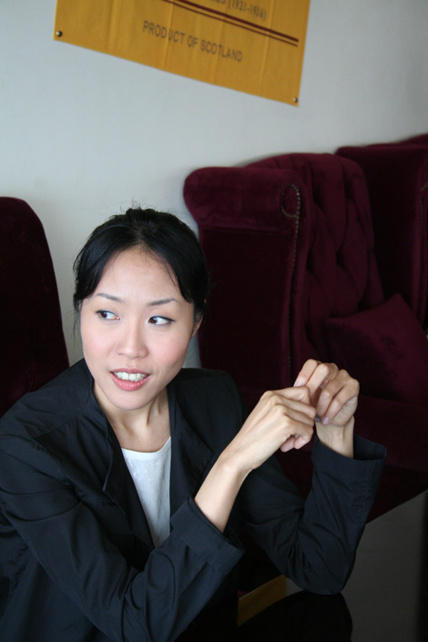
Gina kim
Born 1973 in South Korea.
Gina Kim taught film studies at UCLA and Harvard.
She has contributed to the Asian American film industry through her works Never Forever and Invisible Light displaying stories about Korean American life.

Slide 4
genre
Romance – the love triangle between Andrew Lee, Sophie Lee and Jinah Kim
Drama – Consequences of having an affair, suicide, and lies
These genres together make a great film. The director and writer Gina Kim has used this genre to convey the character’s emotions and themes to create an interesting story.

Slide 5
Never forever plot
Andrew and Sophie are having problems in their relationship. Andrew is distant and unhappy because Sophie cannot give him a child. The hospital says that Andrew’s sperm isn’t healthy enough to conceive a child. Sophie meets Jinah Kim who’s sperm donation was denied by the hospital because is Visa is expired. Sophie seeks out Jinah for his sperm. What was a contract relationship based on money soon becomes an illicit affair.

Slide 6
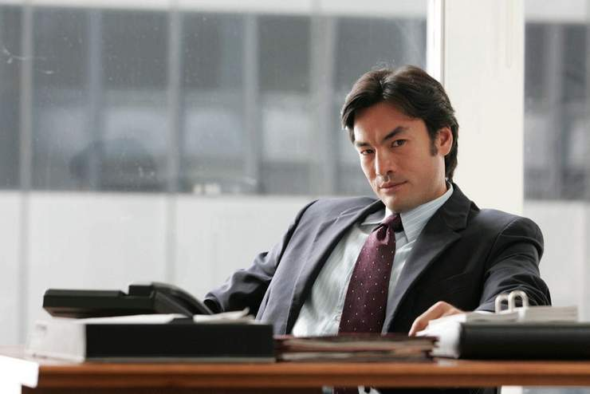
Character analysis: Andrew lee
Distant/ cold husband to Sophie Lee.
Suicidal
Lacks character development throughout the film. The real reason why he has lost hope and become suicidal isn’t clearly stated. However he becomes happy and more attentive to Sophie after finding out that she’s pregnant.

Slide 7
Character analysis: Sophie Lee
A blonde, blue eyed House wife married to a successful Korean Businessman
Desperate for a child to save her marriage with Andrew
Loses site of her sexuality and is overcome with guilt.
Although she is madly in love with Andrew she does hold strong feelings for Jinah.

Slide 8
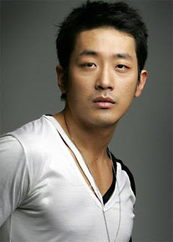
Character analysis: ihah kim
An illegal immigrant who wants to donate his sperm.
Engages in a contract relationship with Sophie which later turns into an illicit affair.
He questions Sophie’s motives for having a child.
His character develops the most in the film.

Slide 9
Theory #1: sexuality
The act of sex without love or any attraction between the participating parties is lonely. Sophie doesn’t feel sexy and therefore cannot perform in sex the way she wants to.
The lack of emotion and trust in Andrew and Sophie’s relationship results in their lack of sexual feelings for each other.
Sophie should know herself and know that’s its okay to have desires and needs.
At first both Sophie and Jinah seem ashamed of their arrangement. However after Sophie and Jinah get to know each other more they create an emotional connection which allows them to feel confident about themselves and have quality sex.

Slide 10
A voice in every wind
Sexuality is a theme in the short story “Angels of the Magpie Bridge.”
The main character Lu Ping is exposed to Americans and American sex culture. After reading the magazine the main character’s development progresses. He now feels more comfortable with exploring the concept of his own sexuality. This may affect how one will think about the world; for example change the way one would think of their own culture’s attitudes toward sex.

Slide 11
M. Butterfly
Sexuality is misconstrued due to gender roles in the M. Butterfly based on play by David Henry Hwang. The fact that a man was seduced by another man in disguise as a woman does not mean that sexual orientation changes.
The two main characters experienced sexual feelings for each other (it is uncertain or left up to the viewer’s interpretation of Song Liling’s true feelings).
These sexual feelings however confused and tragically affected the character of Rene Gallimard.

Slide 12
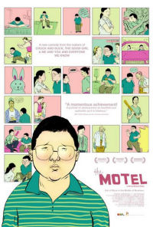
The motel
Directed and written by Michael Kang, based on the novel Waylaid by Ed Lin. The film is about a thirteen year old boy named Ernest Chin who devotes his time to working at his family owned motel.
Sexuality is a theme of this film. As a thirteen year old going through puberty, the main character Ernest has a crush on the character of Christine. In adolescence teens and preteens experience feelings that are usually caused by hormones. By working at this “love” motel Ernest is exposed to prostitution, pornography, and other people engaged in sexuality activities. This shapes his thoughts about sex and the opposite gender.
The theme of sexuality applies to the main character’s development throughout the film (also seen in Never Forever in Sophie’s character).

Slide 13
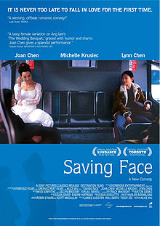
Saving face
Written by Alice Wu, Saving Face is about a Chinese American surgeon experiencing love for the first time with a childhood friend.
Sexuality can refer to sexual orientation as well as having sexual feelings for someone.
The main character Wilamenia (or Wil) falls for her female childhood friend Vivian. As the film progresses the two date secretly. Wil, not comfortable with her sexuality refuses to kiss Vivian in public. This is a deciding factor in their relationship’s future and causes them to separate for three years.
After the three years pass Wil is able to let go, disregard what society (Asian American Community) thinks, and completely embrace her sexuality and feelings for Vivian.

Slide 14
Theory #2: Family issues
The family issue of not being able to conceive a baby affects the characters in so many negative ways. Andrew the husband becomes depressed and feels pressure from his family to have children. Sophie tries to fix the problem by lying and cheating to conceive a baby. She has to deal with guilt and the consequences of her actions. By falling in love with Jinah Kim another family issue of adultery is created.
Family issues can be the source of problems in relationships among spouses, lovers, and married couples. Issues such as these affect character development in literature and film. In Andrew’s case, his character development was lacking but Sophie and Jinah may have developed more positively.

Slide 15
No no boy
No No Boy by John Okada, displays complex family issues involving identity and guilt.
The main character’s mother is in denial about the outcome of World War II which affects the main character and his father. Her ignorance crumbles the family from the inside. The main character struggles internally with his identity as a Japanese American who said no to giving up his heritage. The father resents the mother and separates himself from the family.
After the mother’s suicide (she couldn’t come to terms with the war), the father is relieved and the main character is able to come to terms with his identity. The fact that the mother dies doesn’t solve the issue; the main character and the father should have recognized and dealt with their issues as a family.

Slide 16
Heaven and earth
Story by Le Ly Hayslip, family issues are a recurring theme throughout the film.
Le Ly struggles with her family in Vietnam. She is shunned by her father for having a child out of wedlock, she struggles with her brother joining the war, she leaves her mother and Vietnam for a life with an American soldier.
Her life in America was filled with family issues. Having three kids to raise in America, outside of her own religion in a strange country. Assimilating into an American family that is for the Vietnam war. Marital problems with her husband is the largest family issue because it affects the lives of the children involved.
Issues involving family affect multiple people involved.

Slide 17
Other themes in never forever
Gender Roles
Love
Guilt and Greed
Infidelity
Religion
Social Class

Slide 18
Gender roles
The two main characters are male and female and share different roles in society.
As a house wife, Sophie must fulfill her duties in baring a child to maintain the household.
Andrew, the breadwinner must face the fact that his sperm isn’t healthy enough to conceive a child.
Both face trials that cause them to blame themselves even though the circumstances aren’t under their control.

Slide 19
love
Sophie’s love for Andrew go to great lengths. She breaks the law, cheats, and lies to appease Andrew.
What was an agreement based on money soon turns into love for Jinah. He begins thinking of Sophie and uses what little he has to buy her gift.
However Sophie’s love for her unborn child outweighs her love for both men.

Slide 20
Guilt and greed
Sophie’s guilt for aborting their first child turns into greed.
Sophie’s greed for securing a child for her husband causes her to seek out Jinah Kim who is a total stranger to her.
Her greed for a child turns into a need for a companion who is present in her life emotionally and physically.
These emotions consumed Sophie and drove her to make certain choices.

Slide 21
infidelity
Sophie commits infidelity and ultimately cheats on her husband with Jinah so she can conceive a child. By boring a child with another man.
She is lying to her husband about his ability to conceive.

Slide 22
Religion
Andrew’s family asks Sophie to pray so a child could be born
Sophie doesn’t know how to pray because she didn’t grow up religious. Andrew just prays as if it is second nature to him. He doesn’t believe that God will send them a child. Sophie wants to feel what she prays; she wants to believe in the power of prayer.
Sophie wants to believe in the power of prayer so she can have a child.

Slide 23
Social Class
Sophie and Andrew are of high status because Andrew is a successful businessman.
Jinah Kim is poor illegal immigrant. He has succumb to selling his sperm to survive in America. He expresses his jealously about how perfect yet transparent Sophie’s life is.

Slide 24
Why is this film critically acclaimed?
This film is critically acclaimed because it is well written and directed. The plot serves the audience and the characters well. The climax is the most important part of why viewers critically respond to this film. Although there could have been better character development the main themes of the film invoke thought about real human emotions and how those emotions affect relationships with others.

Slide 25
My critical response
Overall I enjoyed this film. I thought it was romantic and sad. I feel that the three main characters are lost is what they want in life. I pity the characters because it seems like they won’t be able to move on with their lives without finding happiness in the moment. They all seem to be wrapped up in lies, money, and greed. Relationships are always complicated and when emotions such as love, greed and jealously are thrown into the mix things get even more complicated. The only character that seems truly happy at the end of the film is Sophie. She was able to have her child and she is seen pregnant with another in the final scene. But who’s child is it? Is it Andrew’s or Jinah’s?
This drama is filled with many themes that correlate and divide the film based on different interpretations.

Slide 26
Sources
Never Forever (2007) written and directed by Gina Kim
A Voice in Every Wind (2004) by Qun Wang
M. Butterfly (1993) paly and screenplay by David Henry Hwang
The Motel (2006) directed by Michael Kang
Saving Face (2004) directed by Alice Wu
No No Boy (1957) written by by John Okada
Heaven and Earth (1993) story by Le Ly Hayslip

